Slide 2
Brand & Advertising

Slide 3
Video: What is Branding?
https://www.youtube.com/watch?v=sO4te2QNsHY

Slide 4
35 Years of Advertising

Slide 5
Video: 35 Years of Lottery Commercials
(no link)

Slide 6
Our mission:
Change the way The Lottery
is branded and advertised to:
Speak to new generations.
Meet new competition head-on.

Slide 7
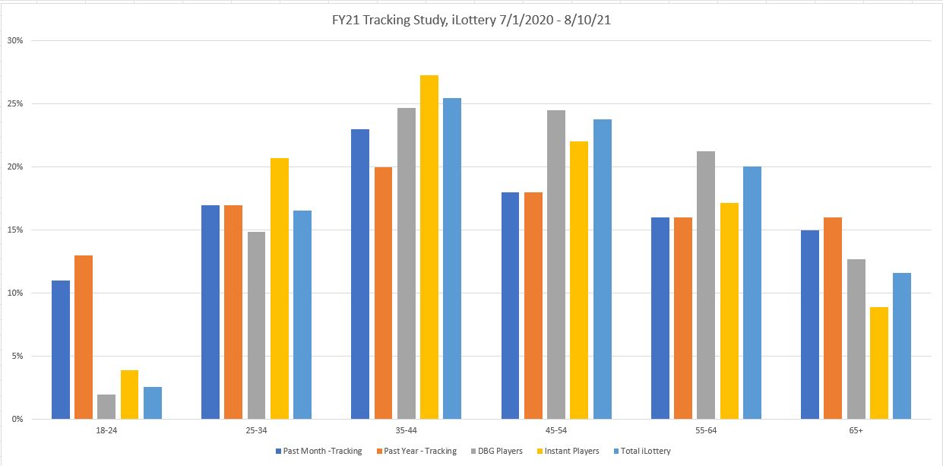
Retail & iLottery Players by Age

Slide 8
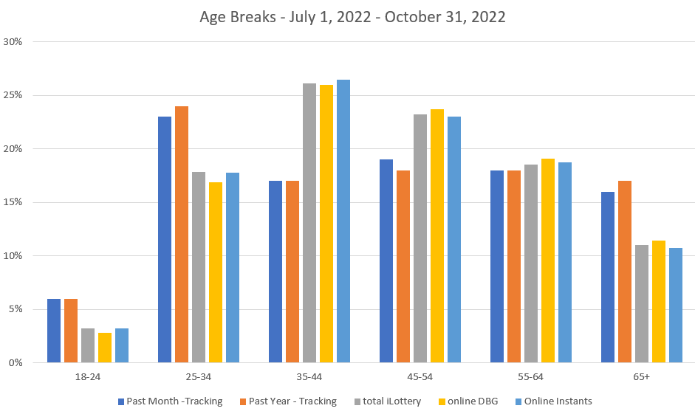
Retail & iLottery Players by Age

Slide 9
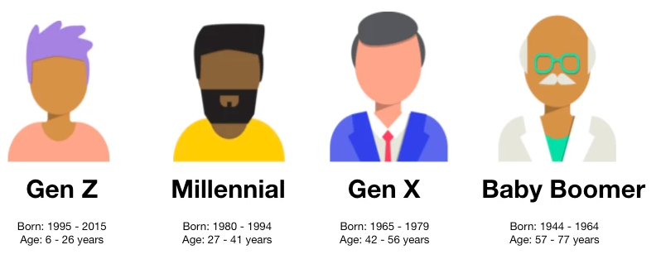
The Generational Shift
CURRENT SWEET SPOT

Slide 10
The Competition 2018

Slide 11
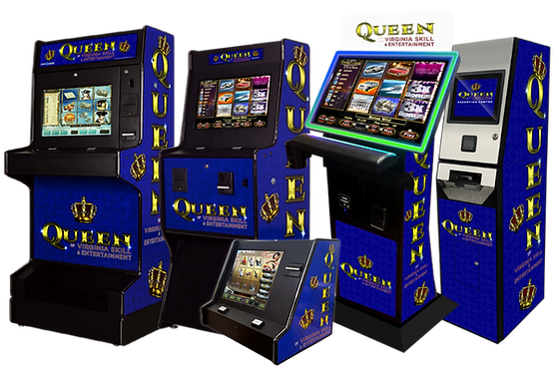
The Competition 2023

Slide 12
Video: How Apple and Nike have
Branded your brain.
https://www.youtube.com/watch?v=4eIDBV4Mpek

Slide 13
Where are we now?

Slide 14
Where are we now?
The rise and fall of “We’re Game”.

Slide 15
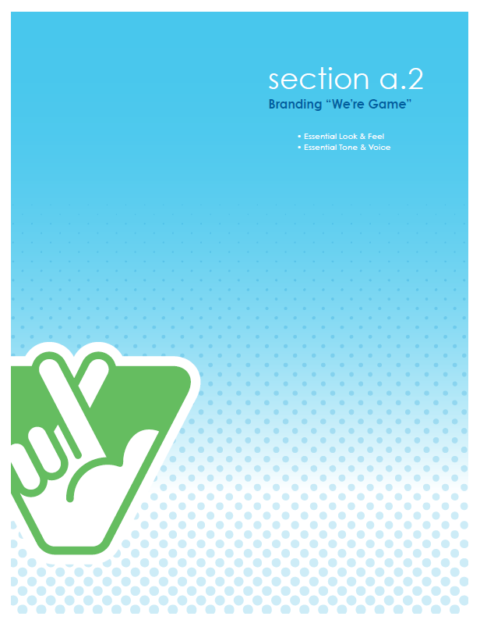

Slide 16
2018
2019
2021

Slide 17
Video: Why Companies are “Debranding”
https://www.youtube.com/watch?v=e1bjkPerpPs

Slide 19
Where are we going?
Complete our brand “refresh” with Fable Branding.

Slide 20
Where are we going?
Complete our brand “refresh” with Fable Branding.
Visual Brand
Brand Voice
Brand Positioning
Go-to-Market Strategy

Slide 21
FY24 Brand & Advertising Calendar
August ‘23
September ‘23
October ‘23
November ‘23
December ‘23
January ‘24
Tuesdays Extension Campaign
Holiday ‘24
B Campaign/TBD
Brand Refresh Work
Brand GTM
February ‘24
March ‘24
April ‘24
May ‘24
June ‘24
July ‘24
Willy Wonka/Golden Ticket
Loyalty Program/TBD
TBD
Brand Go-To-Market Strategy
Brand Launch

